Slide 1
Lecture 8
Process Creation
National University of
Computer & Emerging Sciences

Slide 2
Process Creation and Termination
Creation | Termination
New batch job | Normal Completion
Interactive Login | Memory unavailable
Created by OS to provide a service | Protection error
Spawned by existing process | Operator or OS Intervention
Notes:
There are many reasons why a process may be created or terminated.

Slide 3
What’s Happening at Process Creation?
The OS:
  Assigns a unique process identifier
  Allocates space for the process
  Initializes process control block
  Creates or expand other data structures
Traditionally, the OS created all processes
  But it can be useful to let a running process create another
  This action is called process spawning
    Parent Process is the original, creating, process
    Child Process is the new process
Notes:
Typically, the “related” processes need to communicate and cooperate with each other. Achieving this cooperation is a difficult task for the programmer; discussed further in Chapter 5.

Slide 4
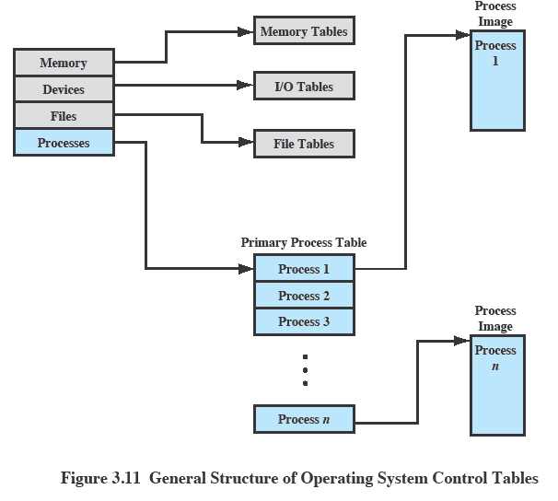
OS Control Tables
Notes:
A general idea of the scope of the tables is in Figure 3.11, which shows four different types of tables maintained by the OS:
memory,
I/O,
file,
process.
Although the details will differ from one OS to another, fundamentally, all operating systems maintain information in these four categories.
You may prefer to stick with this diagram and discuss each from here

Slide 5
Process Termination
Batch job issues Halt instruction
User logs off
Process executes a service request to terminate
Parent terminates so child processes terminate
Operating system intervention
  such as when deadlock occurs
Error and fault conditions
  E.g. memory unavailable, protection error, arithmetic error, I/O failure, invalid instruction

Slide 6
Unix Process Creation
When the system starts up it is running in kernel mode
There is only one process, the initial process.
  SCHED process with PID 0
At the end of system initialization, the initial process starts up another kernel process.
  The init kernel process has a process identifier of 1.

Slide 7

A Tree of Processes

Slide 8
Process Creation
These new processes may themselves go on to create new processes.
All of the processes in the system are descended from the init kernel thread.
You can see the family relationship between the running processes in a Linux system using the pstree command
A new process is created by a fork() system call

Slide 9
Compiling C++ code
g++ test.cpp –o Output
Running the code:
./Output

Slide 10
The fork() system call
At the end of the system call there is a new process waiting to run once the scheduler chooses it
A new data structure is allocated
The new process is called the child process.
The existing process is called the parent process.
The parent gets the child’s pid returned to it.
The child gets 0 returned to it.
Both parent and child execute at the same point after fork() returns

Slide 11
Class-Activity
How many processes will be spawned after executing the above program?
int main()
{
fork();
fork() && fork() || fork();
fork();
printf("forked\n");
return 0;
}

Slide 12
Unix Process Control
int main()
{
int pid;
int x = 0;
x = x + 1;
int pid =fork();
x = 3;
printf(“%d”,x);
}
Notes:
Keep in mind that the fragment of code above includes minimal checking for error conditions, and has potential for confusion about open files and which program is writing to a file. Leaving out the possibility of named files, the new process created by the fork or exec has the three standard files that are automatically opened: stdin, stdout, and stderr. If the parent has buffered output that should appear before output from the child, the buffers must be flushed before the fork. Also, if the parent and the child processes both read input from a stream, whatever is read by one process will be lost to the other. That is, once something has been delivered from the input buffer to a process the pointer has moved on.

Slide 13
But we want the child process to do something else…
The fork syscall returns a zero to the child and the child process ID to the parent
int pid;
int status = 0;
pid = fork();
if (pid>0) {
/* parent */
……
pid = wait(&status);
} else {
/* child */
……
exit(status);
}
Parent uses wait to sleep until the child exits; wait returns child pid and status.
Wait variants allow wait on a specific child, or notification of stops and other signals
Fork creates an exact copy of the parent process
Child process passes status back to parent on exit, to report success/failure

Slide 14
Child Process Inherits
Stack
Memory
Environment
Open file descriptors.
Current working directory
Resource limits
Root directory

Slide 15
Child process DOESNOT Inherit
Process ID
Different parent process ID
Process times
Own copy of files
Resource utilization (initialized to zero)

Slide 16
How can a parent and child process communicate?
Through any of the normal IPC mechanism schemes.
But have special ways to communicate
  For example
    The variables are replicas
    The parent receives the exit status of the child

Slide 17
The wait() System Call
A child program returns a value to the parent, so the parent must arrange to receive that value
The wait() system call serves this purpose
  pid_t wait(int *status)
  it puts the parent to sleep waiting for a child’s result
  when a child calls exit(), the OS unblocks the parent and returns the value passed by exit() as a result of the wait call (along with the pid of the child)
  if there are no children alive, wait() returns immediately
  also, if there are zombies, wait() returns one of the values immediately (and deallocates the zombie)
Notes:
The parent process will often want to wait until all child processes have been completed. this can be implemented with the wait() function call.
wait(): Blocks calling process until the child process terminates. If child process has already teminated, the wait() call returns immediately. if the calling process has multiple child processes, the function returns when one returns.
waitpid(): Options available to block calling process for a particular child process not the first one.

Slide 18
What is a zombie?
In the interval between the child terminating and the parent calling wait(), the child is said to be a ‘zombie’.
Even though its not running its taking up an entry in the process table.
The process table has a limited number of entries.
Notes:
A zombie process is not the same as an orphan process. An orphan process is a process that is still executing, but whose parent has died. They do not become zombie processes; instead, they are adopted by init (process ID 1), which waits on its children.
On Unix and Unix-like computer operating systems, a zombie process or defunct process is a process that has completed execution but still has an entry in the process table. This entry is still needed to allow the process that started the (now zombie) process to read its exit status. The term zombie process derives from the common definition of zombie—an undead person. In the term's colorful metaphor, the child process has died but has not yet been reaped. Also, unlike normal processes, the kill command has no effect on a zombie process.
When a process ends, all of the memory and resources associated with it are deallocated so they can be used by other processes. However, the process's entry in the process table remains. The parent can read the child's exit status by executing the wait system call, at which stage the zombie is removed. The wait call may be executed in sequential code, but it is commonly executed in a handler for the SIGCHLD signal, which the parent receives whenever a child has died.
After the zombie is removed, its process ID and entry in the process table can then be reused. However, if a parent fails to call wait, the zombie will be left in the process table. In some situations this may be desirable, for example if the parent creates another child process it ensures that it will not be allocated the same process ID. On modern UNIX-like systems (that comply with SUSv3 specification in this respect), the following special case applies: if the parent explicitly ignores SIGCHLD by setting its handler to SIG_IGN (rather than simply ignoring the signal by default) or has the SA_NOCLDWAIT flag set, all child exit status information will be discarded and no zombie processes will be left.
Since there is no memory allocated to zombie processes except for the process table entry itself, the primary concern with many zombies is not running out of memory, but rather running out of process ID numbers.
To remove zombies from a system, the SIGCHLD signal can be sent to the parent manually, using the kill command. If the parent process still refuses to reap the zombie, the next step would be to remove the parent process. When a process loses its parent, init becomes its new parent. Init periodically executes the wait system call to reap any zombies with init as parent.

Slide 19
What is a zombie?
If the parent terminates without calling wait(), the child is adopted by init.
The solution is:
Ensure that your parent process calls wait() or waitpid or etc, for every child process that terminates.
Notes:
A process can become orphaned during remote invocation when the client process crashes after making a request of the server
Orphans waste server resources and can potentially leave a server in trouble. However there are several solutions to the orphan process problem:
1. Extermination is the most commonly used technique; in this case the orphan process is killed.
2. Reincarnation is a technique in which machines periodically try to locate the parents of any remote computations; at which point orphaned processes are killed.
3. Expiration is a technique where each process is allotted a certain amount of time to finish before being killed. If need be a process may "ask" for more time to finish before the allotted time expires.
There is no such thing as "zombie process" under Windows, because, strictly speaking, there is no parent-child relationship under Windows. After a child
process has been spawned, it lives its separate life that is totally unrelated to that of a parent process - it will keep on running even after its parent process gets terminated.
As you have properly pointed out, when a process terminates, all handles that it has opened get closed. Therefore, when the parent process terminates,
all its handles are closed, so that reference count on the child process gets decremented. When the reference count gets down to zero, the process
gets removed from the table.

